Slide 1
MOBIMAX APs

Slide 2
MOBIMAX AP OVERVIEW
WiFi Access Points for mobile WiFi deployments
Uses mobile backhaul (3G/4G/LTE) for connectivity
Cloud-based AP Management
Automatic configuration and firmware updates
Central Dashboard and Monitoring
Compatible with wide range of mobile operators
Plug-n-Play Hotspot Deployment
Ideal for travel hotspots, mobile offices, emergency networks, etc

Slide 3
MOBIMAX ADVANTAGES
Benefits
Cloud Managed
Automatic Upgrades
Highly scalable
Single console Mgmt
Reduces IT Cost
Streamline Operations
Simple plug-n-play deployment
Controller-less AP management
Integrated Hotspot Management
Zero configuration deployment
Automatic Firmware upgrades
Central monitoring and reporting
Presence and data analysis for VAR services
Cross Vendor compatibility

Slide 4
MOBIMAX AP VS REGULAR AP
No | Traditional AP | MobiMax Smart AP
1 | Each AP configured individually | Auto configuration from Cloud
2 | Manual or Controller based management | Cloud Managed
3 | Manual Firmware upgrades | Auto Firmware upgrades
4 | Manual Setup | Plug-n-play setup
5 | Requires separate controller | No Controller needed
6 | No Hotspot Features | Integrated Hotspot Features
7 | Requires separate monitoring service | Monitored in Cloud Dashboard
8 | Doesn’t support meshing | Mesh supported
9 | No failover or self-healing mechanism | Auto failover and self healing network
10 | No Presence and data analysis | Presence & Data Analysis in Cloud

Slide 5
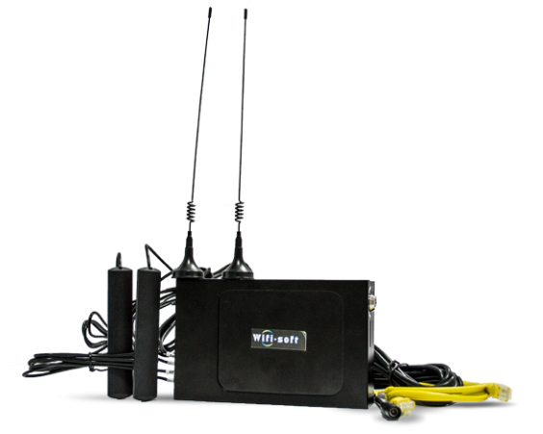
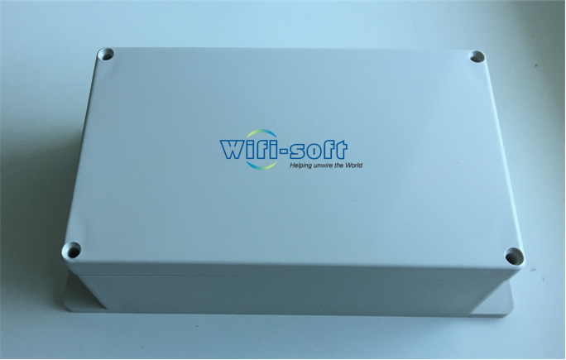
MOBIMAX MODELS
MobiMax 710N | MobiMax 720AC
802.11n 4G/LTE hotspot router | 802.11ac 4G/LTE hotspot router
Single Band | Dual Band
Single 4G/LTE SIM Card | Dual-SIM + Dual-Modem
On-board storage (SD card) | On-board storage (SSD)
External antenna | Internal antenna
Hard metal case (non-weatherproof) | Weatherproof, IP66 plastic enclosure

Slide 6
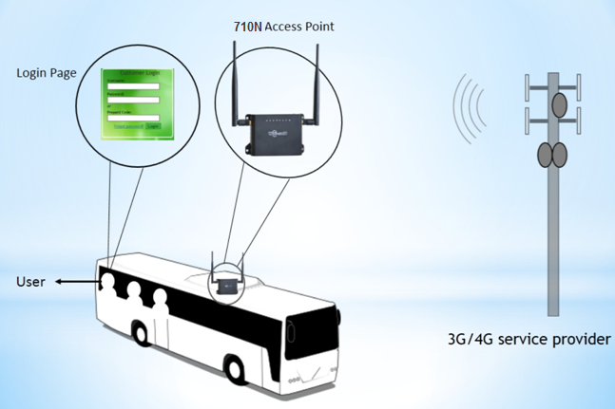
DEPLOYMENT ARCHITECTURE

Slide 7
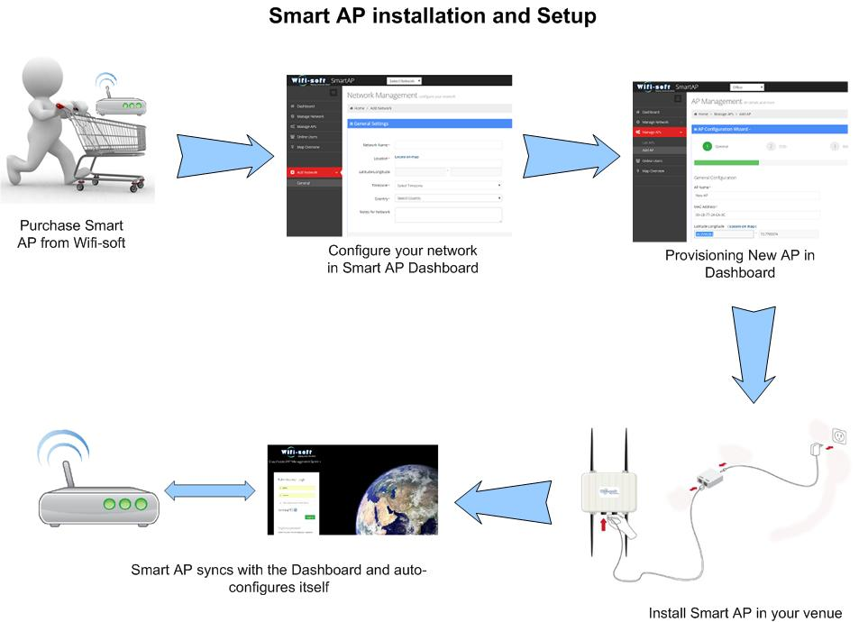
MOBIMAX AP SETUP

Slide 8
UNIMAX FEATURES
Cloud Controlled
Zero configuration
Captive Portals
Bandwidth Control
Wireless Mesh
Hotspot Enabled
Multiple SSIDs
Web logs & URL Filter
Presence
Multiple Models
Auto Channel Selection
Automatic Updates

Slide 9
MOBIMAX DASHBOARD
Manage multiple Smart Networks (hotspots)
Remote monitoring of each Access Point
Central configuration & firmware management
Provisioning of new APs
Hotspot Configuration
Mesh Control
Captive Portal Design
Access Methods – Social Media, Vouchers, Passwords

Slide 10
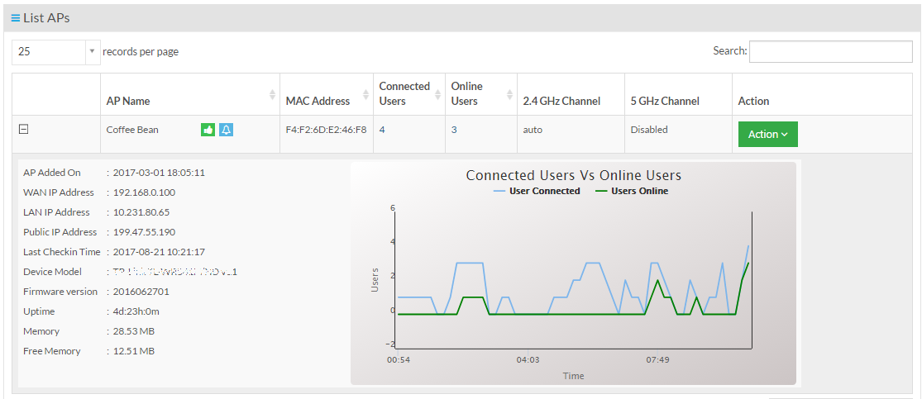
MANAGE AP
Single console AP mgmt
Automatic AP provisioning
Central Firmware Upgrades
RF Analysis
Control channels/TX power
Track bandwidth consumption
Central reboot

Slide 11
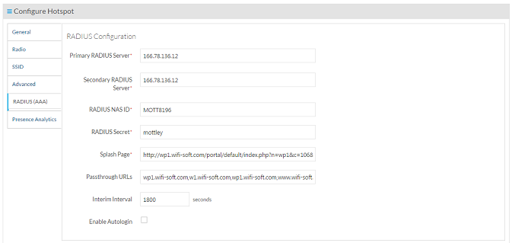
WIFI HOTSPOT
Cloud managed hotspots
RADIUS settings
Customized Captive Portals
Bandwidth control
Automatic MAC authentication
Interim Updates
Passthrough URLs

Slide 12
WIRELESS USERS

Slide 13
THANKS!
Any questions?
Please contact us at
sales@wifi-soft.com | +1-866-554-5090 | +91-20-6715-7355

